Slide 1

Saddleback College CONTRACT EDUCATION
Excel 2016
VBA and Pivot Tables
Alan Foote, PhD
Saddleback College, Mission Viejo

Slide 2
Topics for the course
Excel Tables
VBA/Macros
PivotTables
External Data Objects
Charts and Graphs

Slide 3
Excel Tables
Plan and create a Excel table
Add, edit, and delete records in an Excel table
Filters/Sort/Totals
Slicer

Slide 4
Planning a Structured Range of Data
A collection of similar data structured in a range of columns and rows
Each column represents a field, which is a single piece of data
Each row represents a record, which is a group of related fields
A structured range of data is commonly referred to as a list or table
Data definition table lists the fields to be maintained for each record

Slide 5
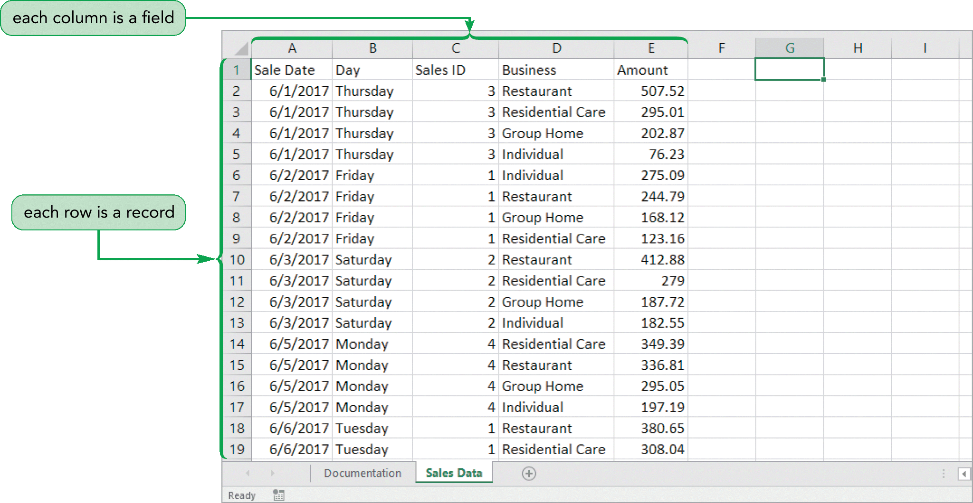
Planning a Structured Range of Data

Slide 6
Naming an Excel Table
Workbook table must have a unique name
Table names start with a letter or an underscore but can use any combination of letters, numbers, and underscores for the rest of the name
Table names cannot include spaces

Slide 7
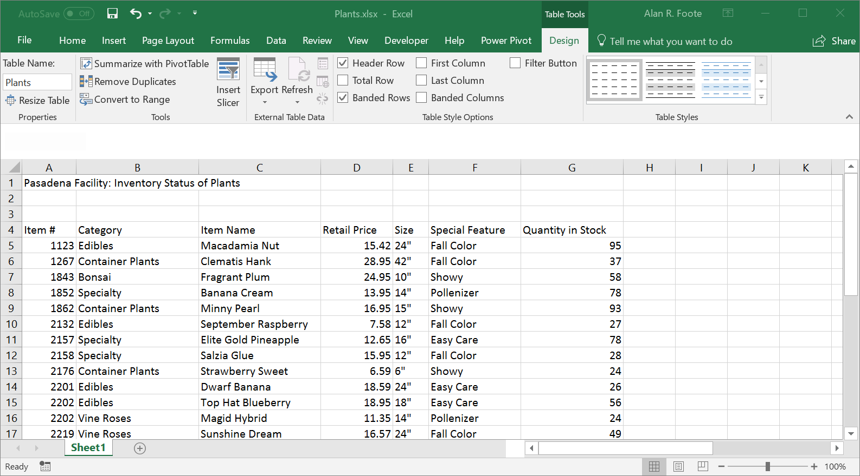
Elements of a Excel Table

Slide 8
Filtering Data
Filtering hides records that do not meet the criteria
Data can be:
Sorted
Copied
Formatted
Charted
Printed

Slide 9
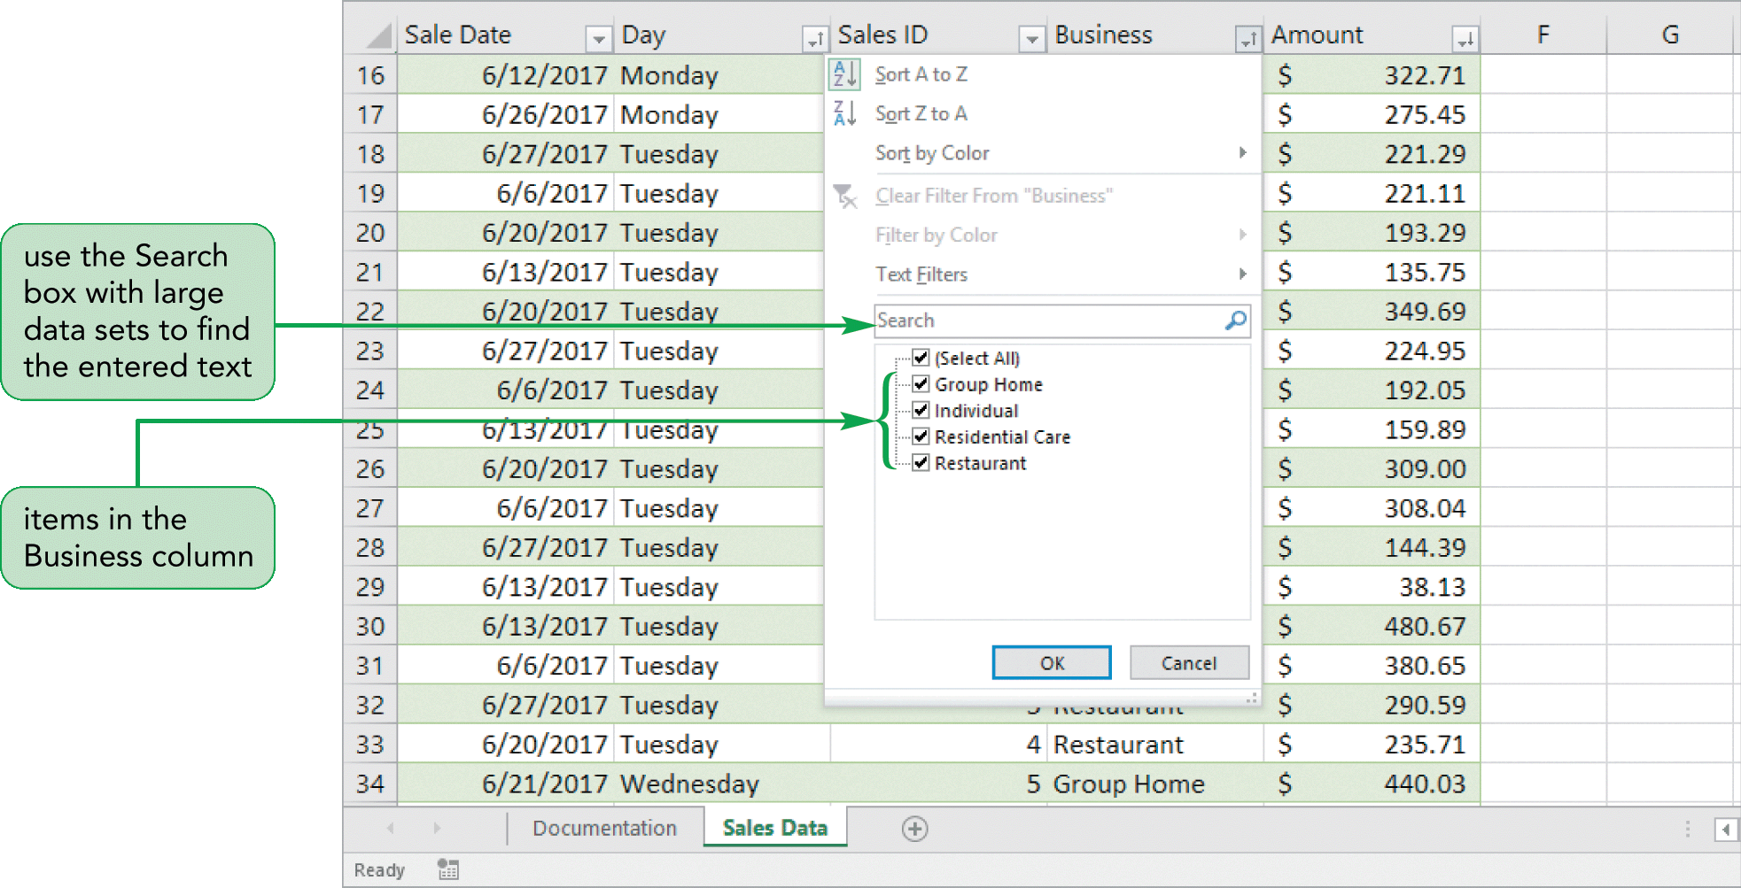
Filtering Data

Slide 10
Using a Slicer to Filter Data
Slicer to filter a table
Every slicer contains a button for each unique value
Format the slicer and its buttons, changing its style, height, and width

Slide 11
Creating Sparklines
A sparkline is a chart that is displayed entirely within a worksheet cell
Sparklines are compact in size
Sparklines are useful when you need a simple chart

Slide 12
Three types of Sparklines
Line sparkline: Highlights trends
Column sparkline: For column charts
Win/Loss sparkline: Highlights positive and negative values

Slide 13
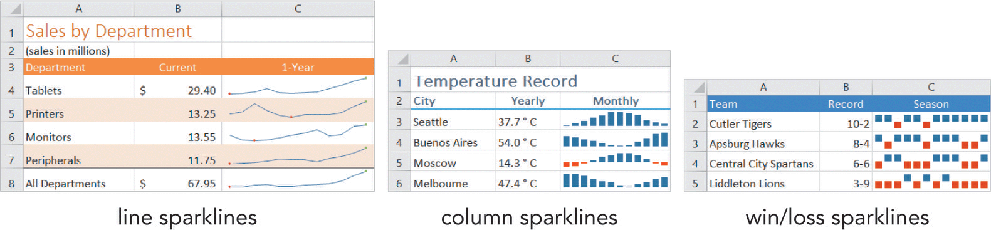
Creating Sparklines

Slide 14
Creating Data Bars
Conditional format that adds a horizontal bar to background
Length based on value of each cell
Dynamic—lengths of data bars changes if cell’s value changes
Modifying a Data Bar Rule

Slide 15
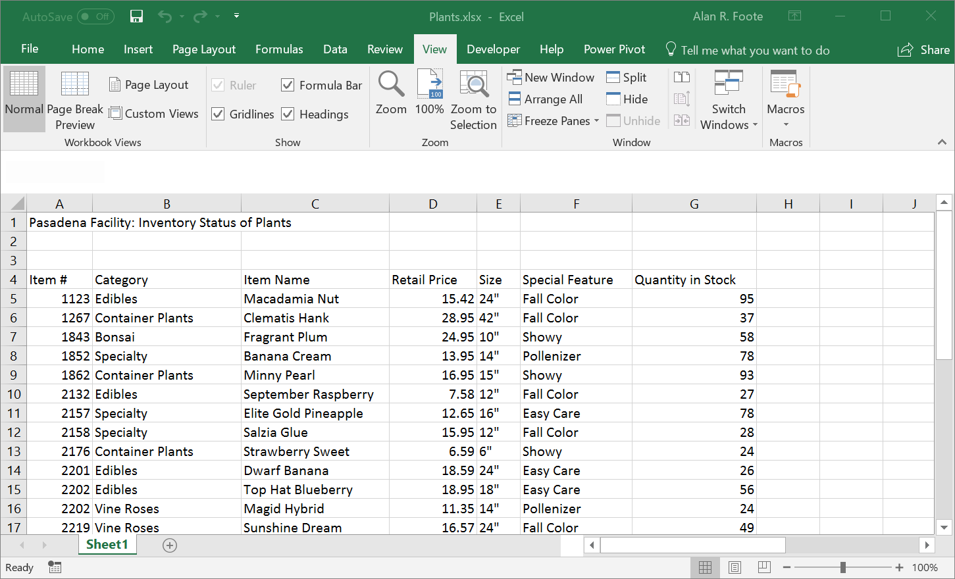
Freezing Rows and Columns
Freezing a row or column keeps headings visible as you work with data in a large worksheet

Slide 16
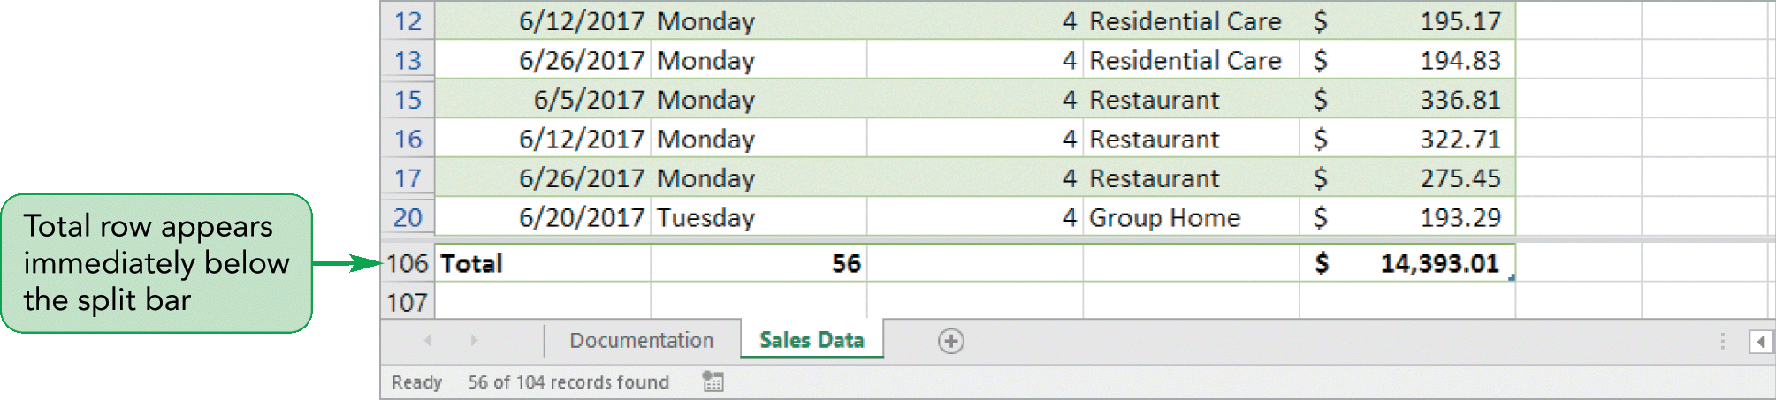
Splitting the Worksheet Window into Panes
Easily view data from several areas of the worksheet at the same time
Ribbon processing – View/Window/Split

Slide 17
Subtotal Commands
Summary information (counts, sums, averages, minimums, maximums)
Inserts a subtotal row for each group of data
Adds a grand total row
Cannot be used in an Excel table
Convert the Excel table to a normal range
Sort data for grouping together before using Subtotal command

Slide 18
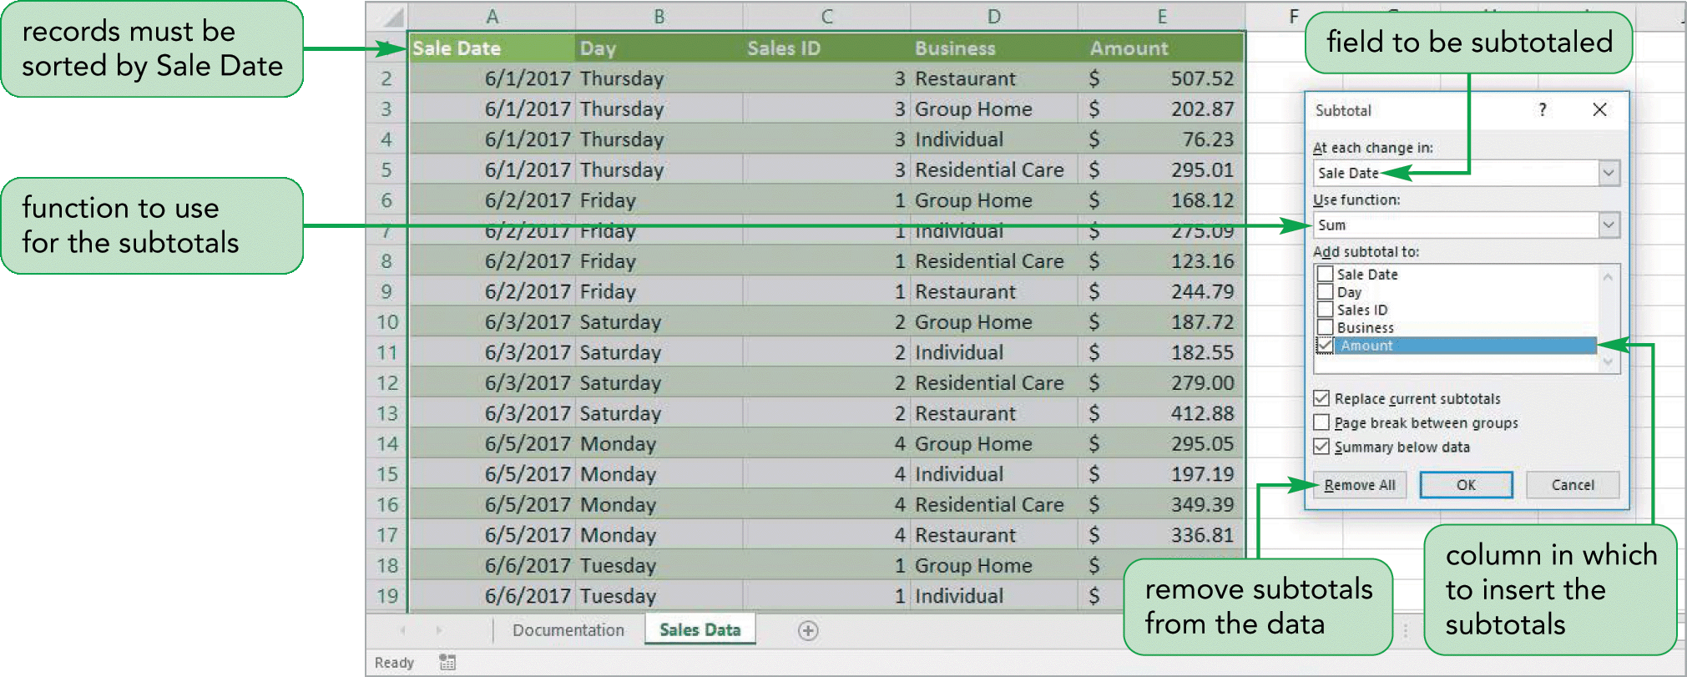
Inserting Subtotals

Slide 19
Subtotals Outline View
Control the level of detail with buttons
Level 3: Most detail
Level 2: Subtotals and grand total, but not individual records
Level 1: Only the grand total

Slide 20
Using a Lookup Function
Lookup functions find values in tables of data
An exact match lookup
An approximate match
Both the VLOOKUP and HLOOKUP functions are used to return a value from a lookup table

Slide 21
Using LOOKUP Functions
VLOOKUP(lookup_value,table_array,col_index_num[range_lookup])
HLOOKUP(lookup_value,table_array,row_index_num[,range_lookup])
Sort the table_array from lowest to highest
Major difference between HLOOKUP and VLOOKUP functions is the way lookup tables are organized

Slide 22
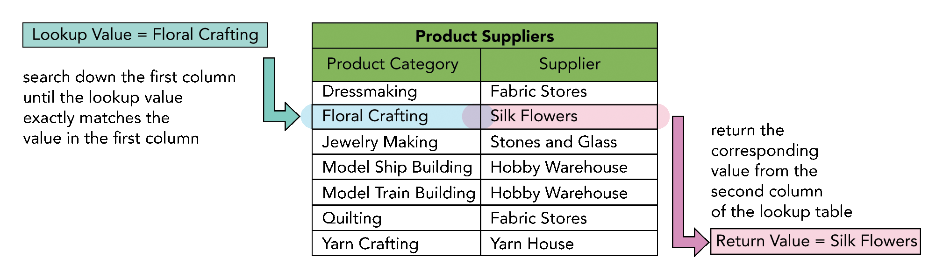
Using LOOKUP Functions

Slide 23
Using VLOOKUP Function for Approximate Match
Returns a value based on an approximate match lookup in the first column of the table
The values in the first column or row of a lookup table represent a range of values sorted from lowest to highest

Slide 24
Excel Table Exercise
Open OpticalSunglases.xlsx
Convert Range A2:G16 to a table – Optical
Add Total Row and Total 2018-2020
Filter by Shape
Sort by Product Code
Add data bars to 2018
In Cell B21 – Enter Product Code
In Cell B22 – Vlookup for 2018 Sales (Column E)
In Cell B23 – Vlookup for 2019 Sales (Column F)
In Cell B24 – Vlookup for 2020 Sales (Column G)

Slide 25
Creating an Application
Use defined names in formulas
Add defined names to existing formulas
Create validation rules for data entry
Protect the contents of worksheets and workbooks
Add, edit, and delete comments
Macros and VBA

Slide 26
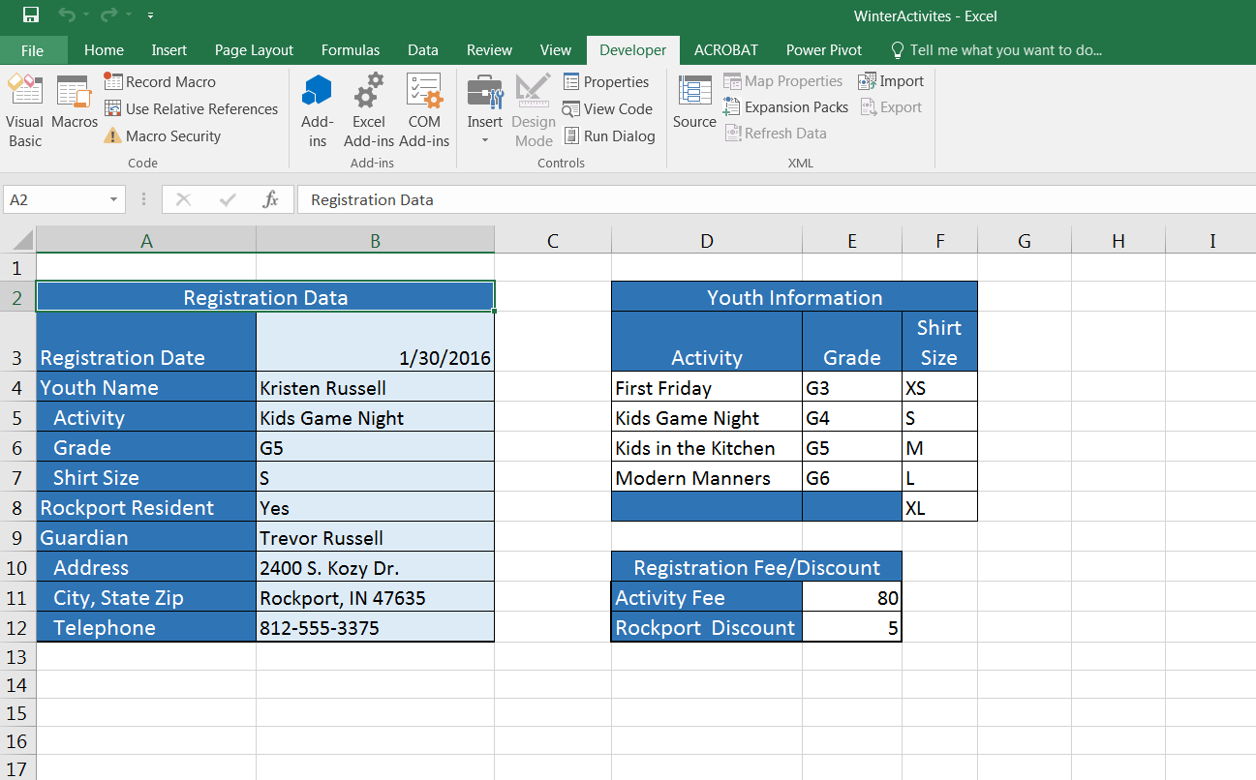
Visual Overview: Excel Application and Defined Names

Slide 27
Planning an Excel Application
An Excel application is a spreadsheet written to meet a business need
Enter and edit data
Store data
Formulas for calculations on data
Display outputs- reports and charts

Slide 28
Naming Cells and Ranges
Must begin with a letter or _ (an underscore)
Letters and numbers as well as periods and underscores
No spaces
Up to 255 characters
Not case sensitive

Slide 29
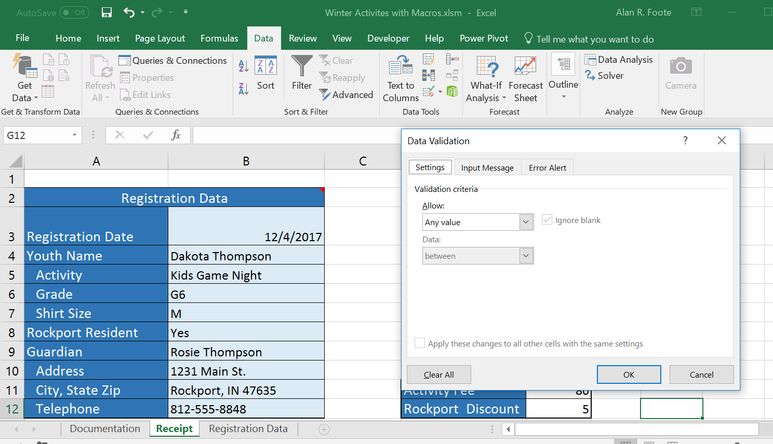
Visual Overview: Data Validation and Protection

Slide 30
Validating Data Entry
Validation rule provides criteria for the data
Input and error alert messages
Input message, and the error alert

Slide 31
Data Entry Error Alert Style and Message
Stop: Prevents the entry
Warning: User may override the rejection and continue using the data
Information: Accepts the data value entered

Slide 32
Validating Data Entry by Creating an Input Message
Reduce data-entry error by displaying an input message
Additional information about the type of data
Input messages appear as ScreenTips
Can add an input message to a cell without a validation rule

Slide 33
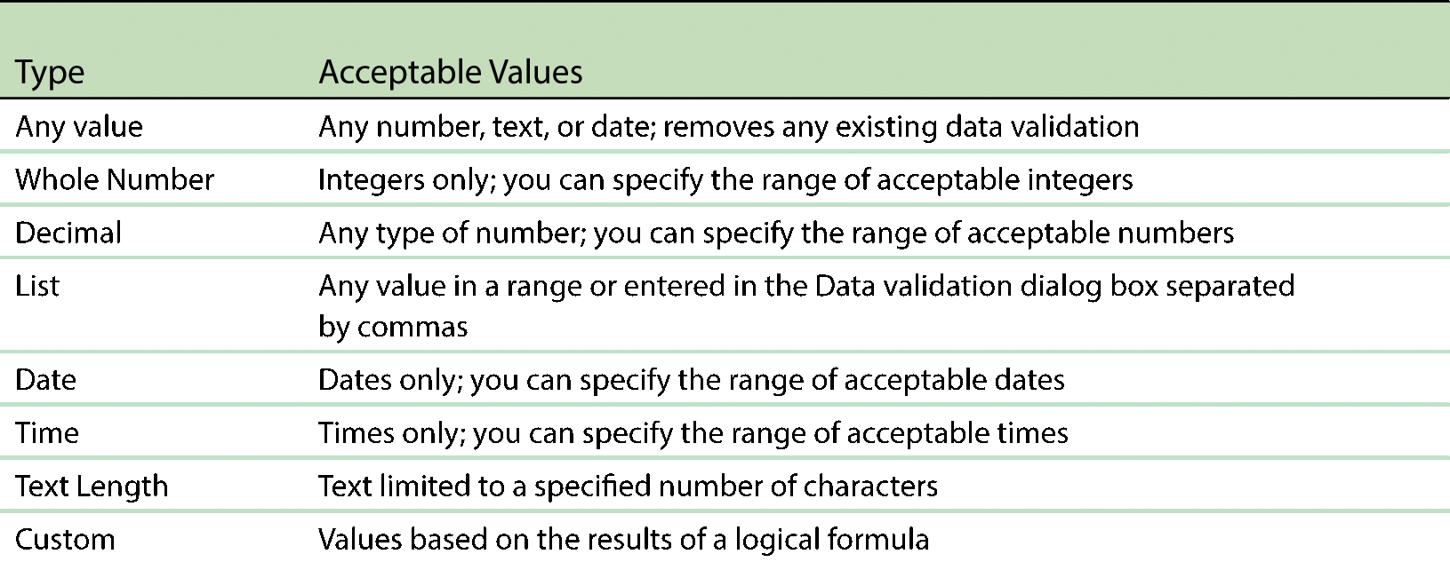
Validating Data Entry

Slide 34
Data Entry List Validation Rules
Data validation feature to accept only entries that are on a list
List box with the possible values appears for the user
Test validation rules by entering incorrect values that violate the validation rules

Slide 35
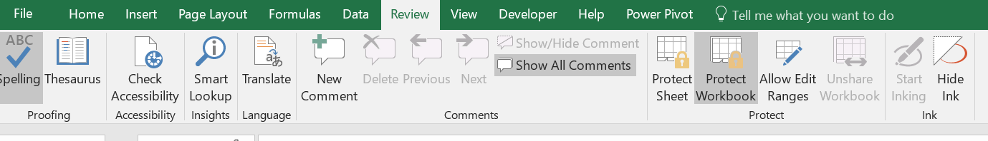
Protecting Worksheet and Workbook
Worksheet protection prevents users from changing cell contents
Workbook protection also prevents users from changing the workbook’s organization
Can keep users from viewing the formulas

Slide 36
Locking and Unlocking Cells
Locked property for each cell
After Worksheet is protected, the locked property controls cell use
By default, locked property – off, and worksheet protection - off
If cells in a worksheet are locked before protecting the worksheet, all of the cells in the worksheet will be locked

Slide 37
Locking Cells (cont.)
Protect the worksheet but leave some cells unlocked
First, turn off the locked property of cells in for data entry
Then, protect the worksheet to activate the locked property for the remaining cells

Slide 38
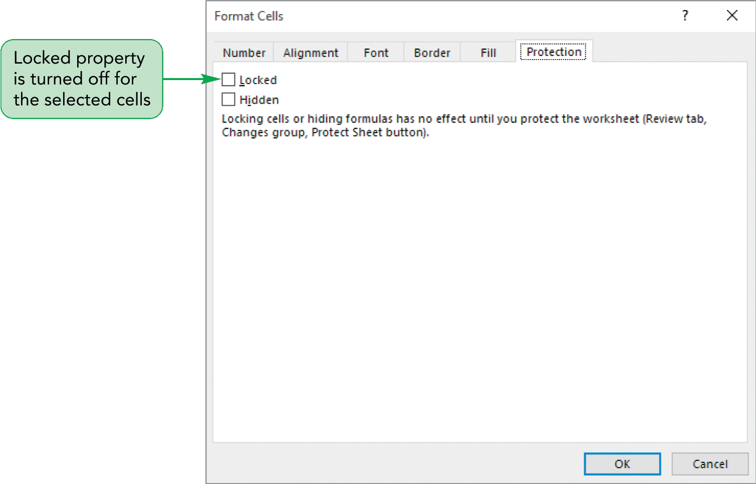
Protecting a Worksheet and Workbook

Slide 39
Protecting Worksheet and Workbook
When you set up worksheet protection, specify which actions are still available to the user
User can only access unlocked cells, or allow the user to select any cell in the worksheet; choice remain active as long as the worksheet is protected
Add a password to turn off the protection

Slide 40
Protecting Worksheet and Workbook
Worksheet protection applies only to the contents of a worksheet
To keep a worksheet from being modified, protect the workbook
Protect the structure and the windows of a workbook
Protecting the structure prevents users from renaming, deleting, hiding, or inserting worksheets

Slide 41
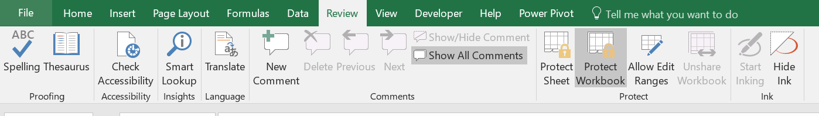
Inserting Comments
Comments are added to
Explain the contents of a particular cell
Provide instructions to users
Share ideas and notes

Slide 42
Inserting Comments
If you collaborate on a workbook, the top of the comment boxes would show the name of each user
A small red triangle appears with a comment
The comment box appears when you point to the cell

Slide 43
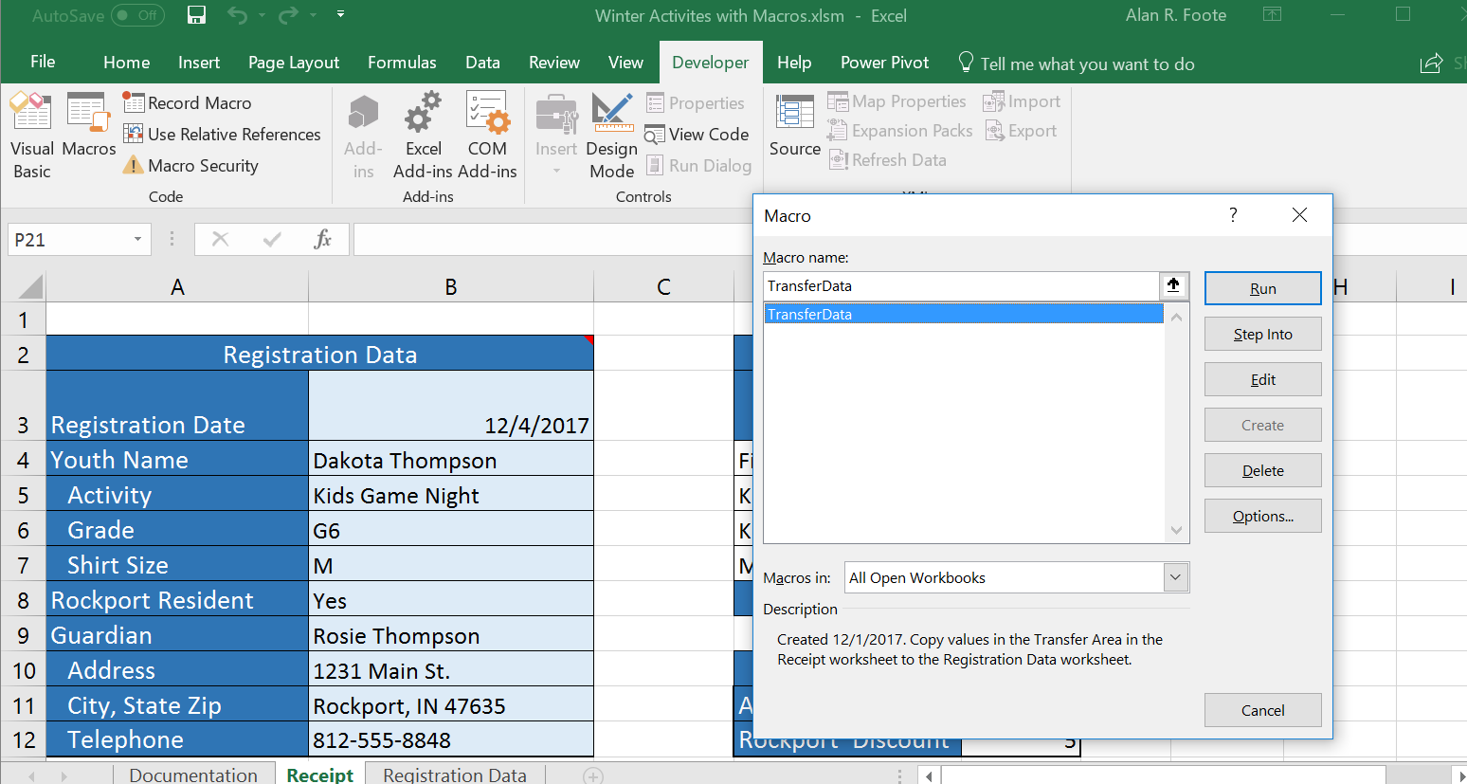
Visual Overview: Working with Macros

Slide 44
Automating Tasks with Macros
Macros automate any task you perform repeatedly
Macros perform repetitive tasks consistently and faster than you can.
After the macro is created and tested, you can be assured the tasks are done exactly the same way each time
To create and run macros, you need to use the Developer tab

Slide 45
Protecting Against Macro Viruses
Macro viruses use a program’s own macro programming language to distribute the virus
Can be destructive
Can modify or delete files that may not be recoverable
Cause network problems

Slide 46
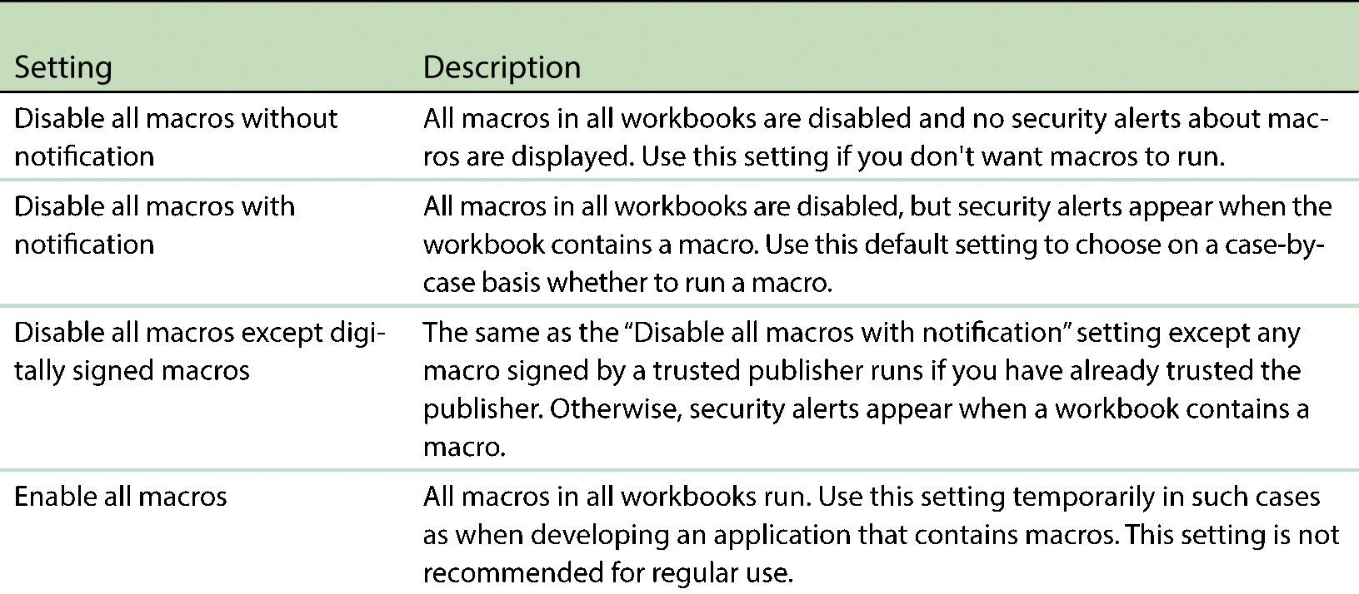
Protecting Against Macro Viruses Security Settings

Slide 47
Creating a Macro
Use the macro recorder to record keystrokes
Enter a series of commands in the Visual Basic for Applications (VBA) programming language

Slide 48
Recording a Macro
Macro stored in the current workbook (only available with that workbook)
Store the macro in the Personal Macro workbook, a hidden workbook named Personal.xlsb that opens whenever you start Excel
Can store the macro in a new workbook

Slide 49
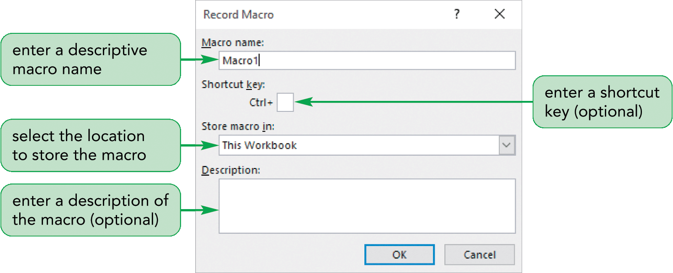
Recording a Macro

Slide 50
Running a Macro
Excel performs each of the steps in the same order as when it was recorded
Use the shortcut key you specified or select the macro in the Macro dialog box

Slide 51
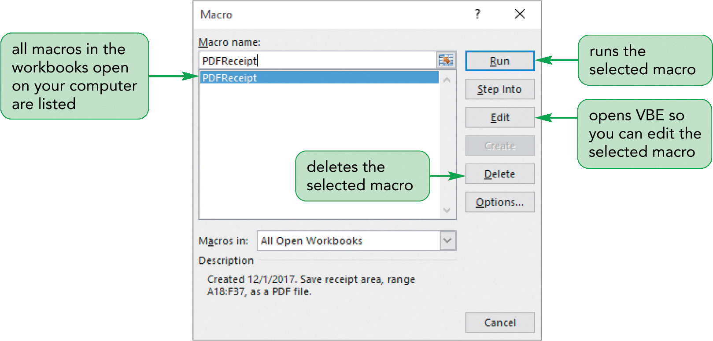
Running a Macro

Slide 52
Fixing Macro Errors
Rerecord the macro
Delete the recorded macro, and then record the macro again
Run the macro using Step into

Slide 53
Working with the Visual Basic Editor
To view the code of a macro, open the Visual Basic Editor (VBE)—
The Macro dialog box (Edit) or the Visual Basic button in the Code group on the Developer tab

Slide 54
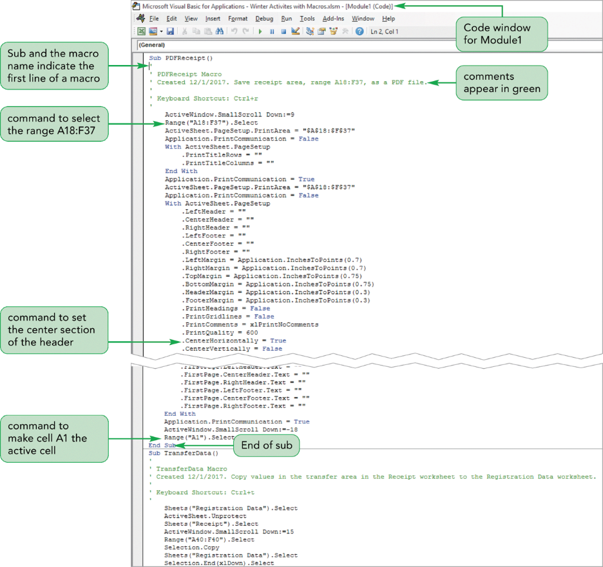
Working with the Visual Basic Editor

Slide 55
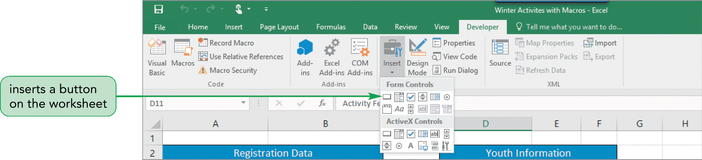
Creating Macro Buttons
Run a macro with a button on the worksheet
Macro buttons are often a better way to run macros
Clicking a button (with a descriptive label) is simpler for users than trying to remember different combinations of keystrokes

Slide 56
Saving a Workbook with Macros
Warning about Saving with Macros
The default Excel workbook does not allow macros to be stored as part of the file and has the .xlsx file extension
A macro-enabled workbook has the .xlsm file extension
Open a file with macros, a SECURITY WARNING appears

Slide 57
Macro Exercise
Open OpticalDataEntry.xlsx
Create Macro –AddtoTable
The macro transfer data from the DataEntry worksheet –Cells (A10:G10) to end of table on SunglassData worksheet.
Use Type and Material as rows
Totals for 2018, 2019 and 2020
Filter by Shape
Add a Clustered Column Pivot Chart
Add a linear trendline based upon Sales for 2020

Slide 58
PivotTables
Create and modify a PivotTable
Apply PivotTable styles and formatting
Filter a PivotTable
Insert a slicer to filter a PivotTable
Insert a recommended PivotTable

Slide 59
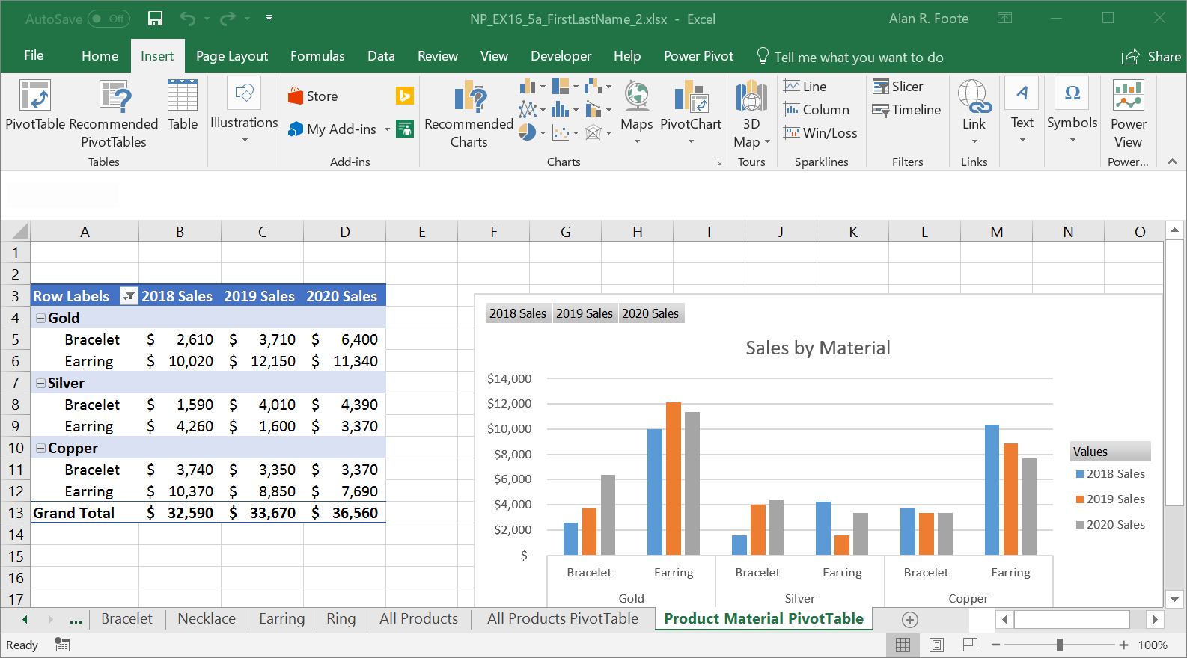
Visual Overview: PivotTable and PivotChart

Slide 60
Analyzing Data with PivotTables
Large amounts of unorganized data
PivotTables help organize data by summarizing data into categories using functions
“Pivot” the table - rearrange, hide, and display fields to provide alternative views of the data

Slide 61
Adding Fields to a PivotTable
Summary data fields are Values fields
Grouping the values into Category fields
PivotTable Fields pane is divided into two sections:
The Fields section lists the names of each field in the data source
Lower Section - adds field to the FILTERS, ROWS, COLUMNS, or VALUES area

Slide 62
Filtering a PivotTable
Filtering to show only a portion of the total data
In the FILTERS Area
Create a filtered view of the PivotTable report
Focus on a subset of items in that field
Filter Field Menu

Slide 63
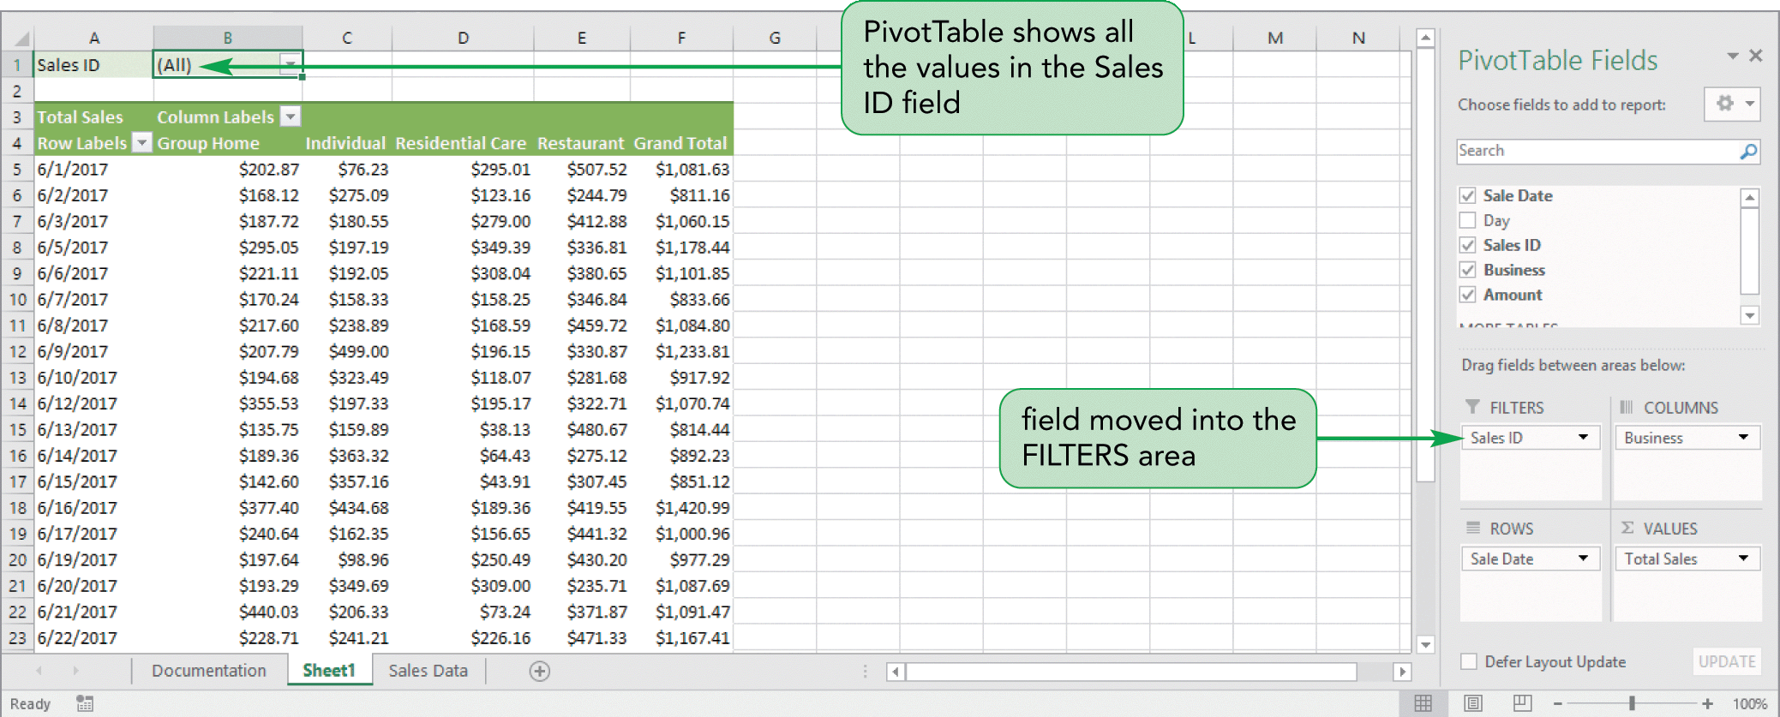
Filtering a PivotTable

Slide 64
Creating a Slicer to Filter a PivotTable
Filter a PivotTable is with a slicer
Slicer for any field in the PivotTable Fields pane
Slicer for each unique value in that field
Format the slicer by changing its style, height, and width
More than one slicer at a time

Slide 65
Refreshing a PivotTable
First, edit the data source on which the PivotTable is created
PivotTables are not updated automatically
Refresh the PivotTable report to reflect the revised calculations

Slide 66
Creating a PivotChart
Graphical representation of the data in a PivotTable
Add, remove, filter, and refresh data fields
Format PivotCharts as other charts, including layouts and styles
Resize chart elements, format of individual data points

Slide 67
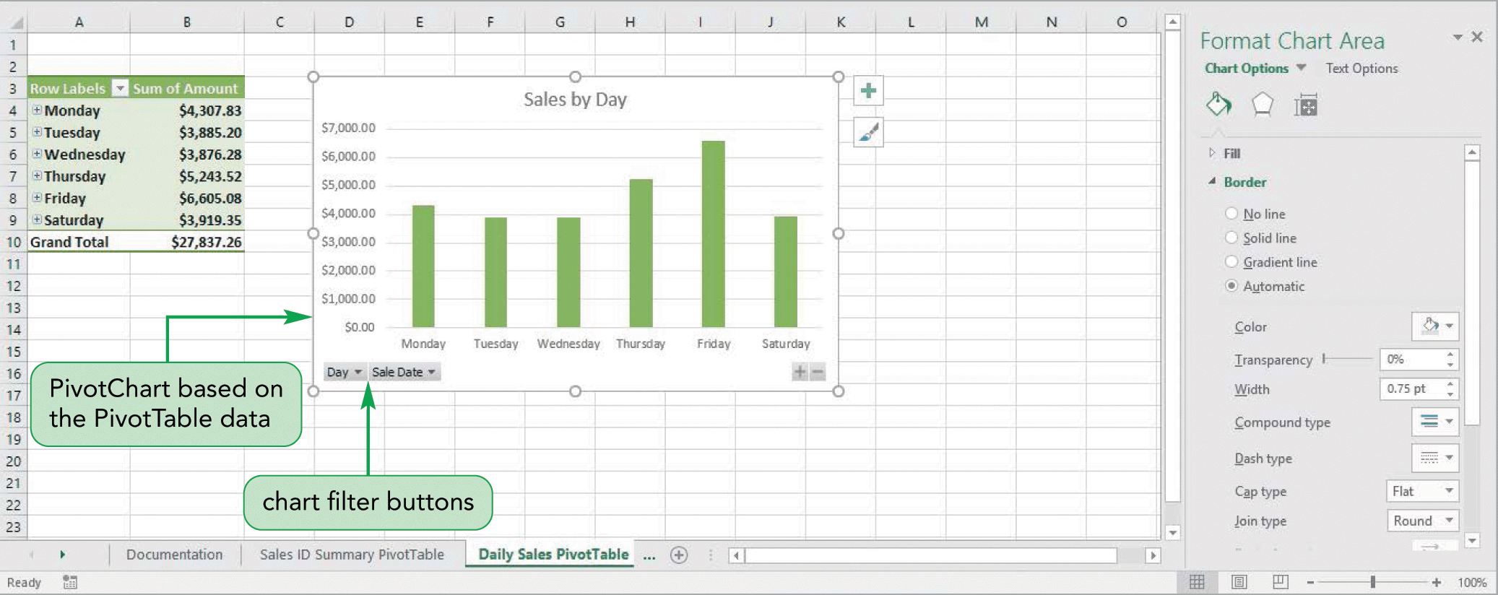
Creating a PivotChart

Slide 68
Creating a PivotChart
The PivotChart Tools work with the selected PivotChart the same way as an ordinary chart
A PivotChart and its associated PivotTable are linked
Different views of the PivotChart by using the chart filter buttons

Slide 69
PivotTable Exercise
Open OpticalAllProducts.xlsx
Create PivotTable on new Worksheet
Use Type and Material as rows
Totals for 2018, 2019 and 2020
Filter by Shape
Add a Clustered Column Pivot Chart
Add a linear trendline based upon Sales for 2020

Slide 70
Using Templates
A template workbook is a model from which you create new workbooks
Any changes or additions made to the new workbook do not affect the template file

Slide 71
Existing Templates
Office.com
Family Monthly Budget Planner
Inventory List
Team Roster
Time sheets
Expense Report

Slide 72
Creating a Custom Workbook Template
A custom template is a workbook template created by the user
Build with the formulas included and all formatting
Save the workbook as a template

Slide 73
Creating a New Workbook from a Template
Access the template from the New screen in Backstage view
Original template file is not changed
Save new workbook without changing template

